Slide 1




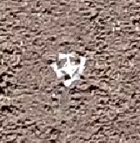
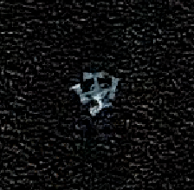
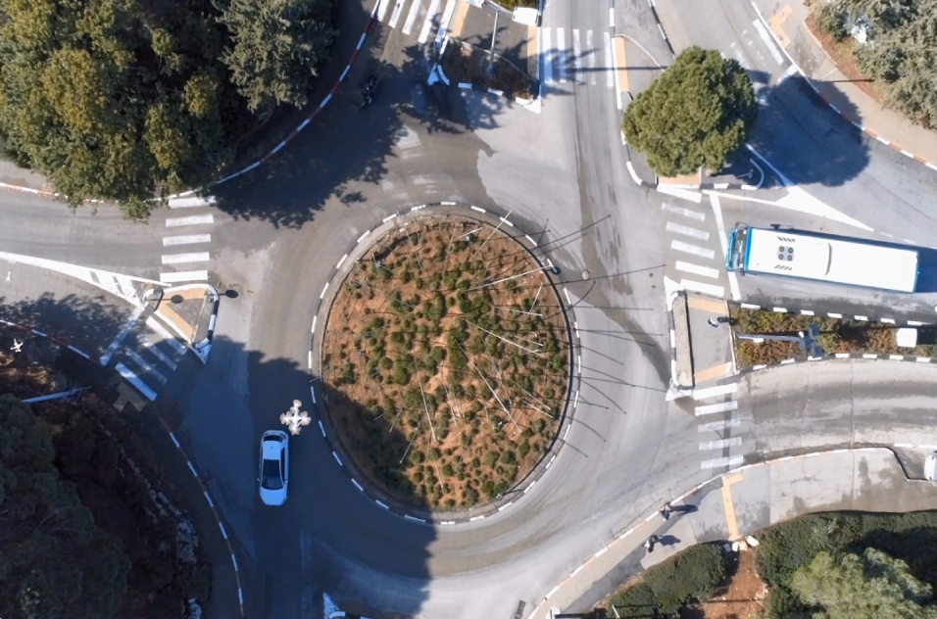
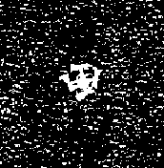
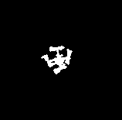
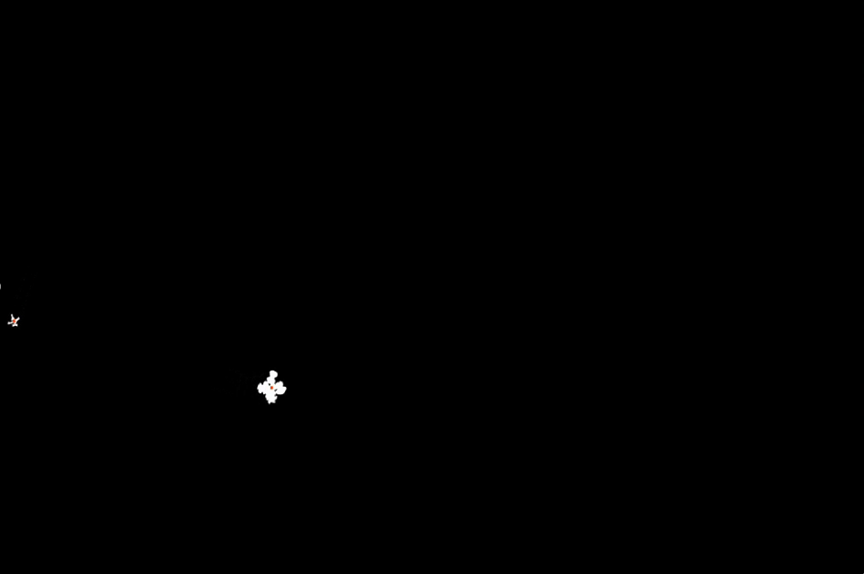
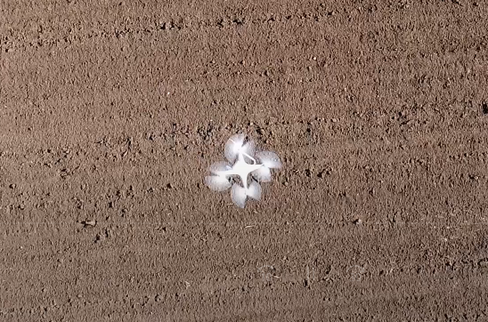
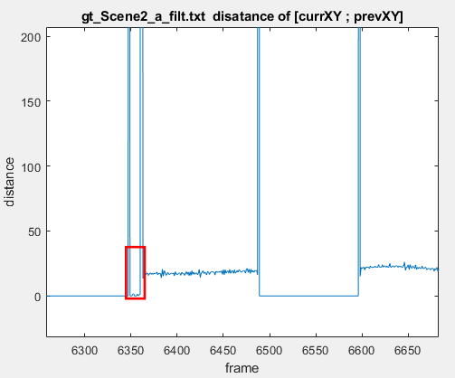
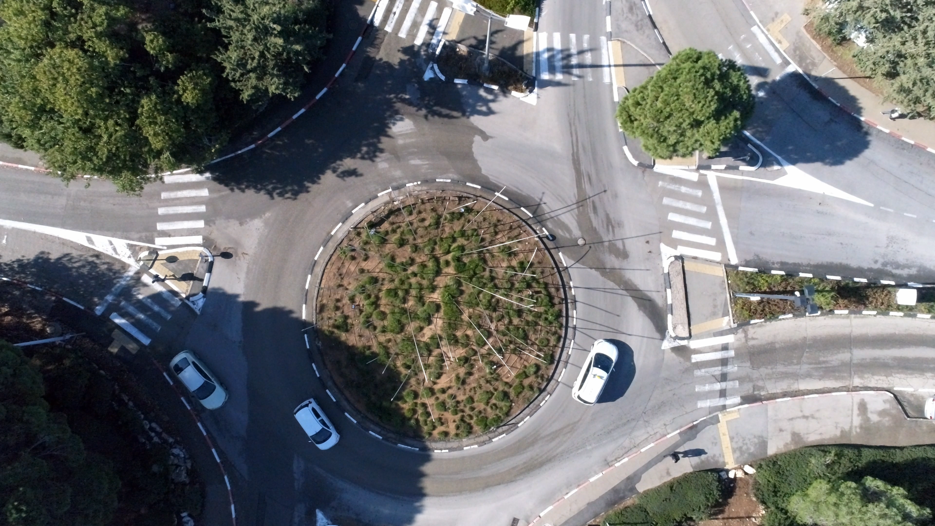
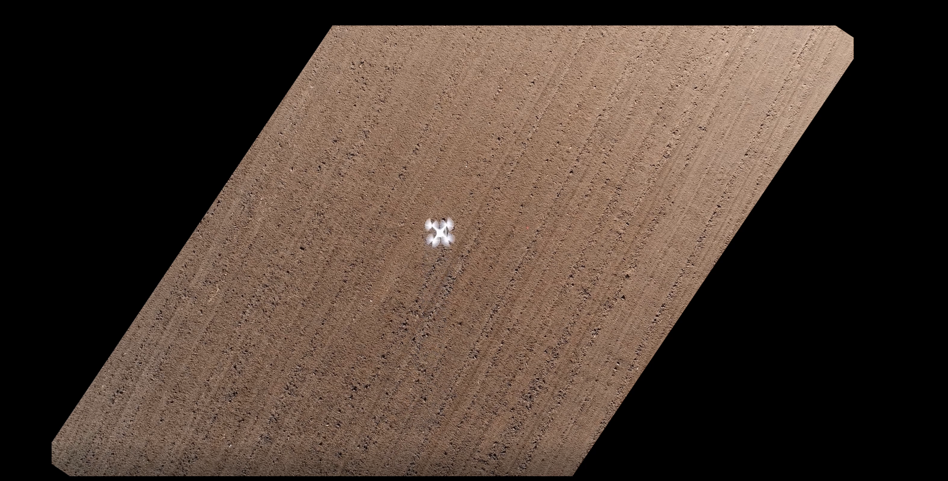
Video Dataset for Drone Detection and Tracking via Video Merging and Augmentation
Aviv Paskaro and Stav Yeger, supervised by Ilya Tcenov
Introduction
Algorithm & Process
Results
Information gathering and terrorism are made commonly by drones because of its easiness of operating and the size and the unman-ness
Our ultimate goal is to monitor and neutralize hostile drones in urban environments
Detection and tracking after a specific object in a video containing lots of dynamic objects, using simple image processing tools, is problematic.
We assume that detection of moving object (drone) will be much easier under some assumptions with a static background
Remove background
Augmented and variant videos dataset in high definition, with matching ground-truth
Used as a basis for qualitative learning of a neural network
Find the median value in time of each pixel and substitute it from the original pixel in order to remove the background
Use morphological filters and data from previous frames in order to create a clean binary picture of the drone
Run one time run for all the drone videos to create the ground-truth videos dataset
Using a graph of the center of mass differentiation, we are able to monitor the distortions in the GT videos and fix them
Picking random (time weighted) videos from the dataset, then pick a random block of frames
Add random changes for the augmentation (scaling, Rotating, shifting, color and transparency changing) to the drone and ground truth videos
Merge between the picked urban and drone videos using the ground truth binary frames and alpha blending
Goal
Create a diverse and reliable dataset of short videos which are containing drone/s flying above urban area include moving people, cars, bikes, etc. and also matching videos of the ground truth - the location of the drone in each frame.
Videos that simulate drones in an urban environment
Dataset
Create a data of two different kind of videos:
Aerial view of a drone moving above a dark-static background
Aerial view of an urban scene contains many moving objects
Videos are taken in 4K resolution, 25 FPS
There are 3.75 hours of each kind of the two video types, divided into categories of different heights of the drone, different move patterns etc.
The videos are taken from 50m height
The videos are taken in day-light
The filmed drone is between 10-40m height
Clear distortions
Binary video as a ground truth with a center of mass for each drone
Pros of Proposed Method
Use the real drone movement - Characterize drone’s motion
High match rate and high accuracy ground-truth
A large number of augmentation parameters and different drone scenes Ensuring variability in the dataset
Randomization Augmentation & Merging
Cons
Possible defects with merging the videos
There may be non-physical cases (wind, lighting differences and more) that would impair the reliability of the dataset
Requirements & assumptions
Conclusions
We have received high-quality videos and we hope the videos can serve as a reliable vast and varied repository for a training of the neural network that will eventually identify drones in urban environments.
April 2020

